Slide 1
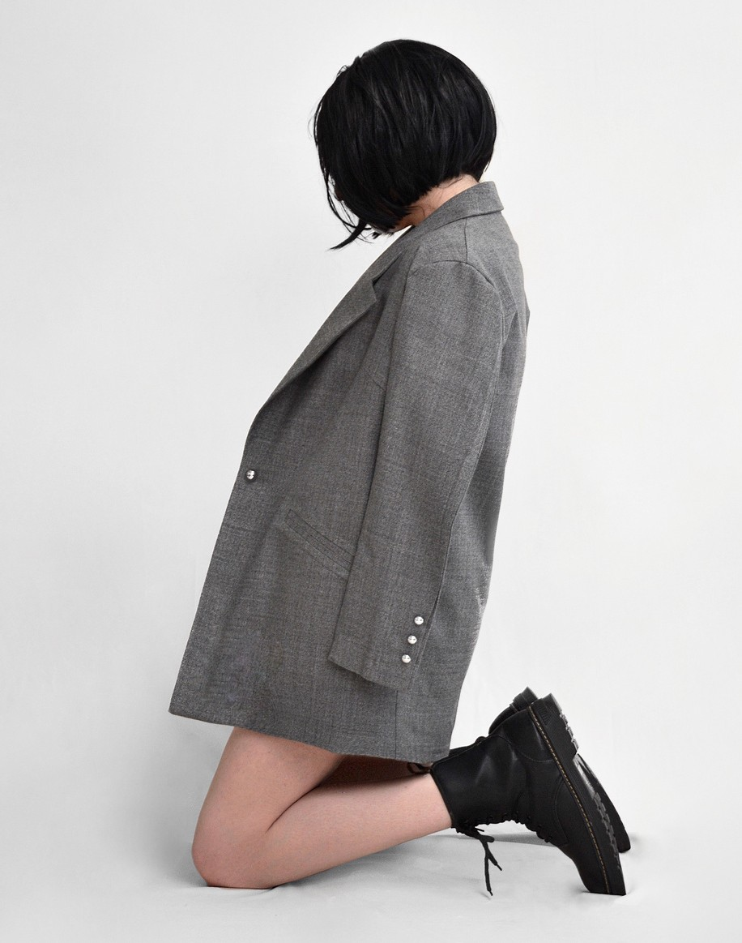
Issue 08
Brussels
Divine
designs
Vol
01
A range of unique fashion references for today's current period
Exclusively: 2023 new collection

Slide 2
ABOUT
Us
Awareness of environmental sustainability does not only occur in the industrial and eco- nomic fields, but also in the fashion sector. Read how this awareness permeated the mo- dern fashion industry and how it came about. Having several characteristics such as being able to be recycled, being upcycled, cruelty-free, not made of chemicals that can pollute the environment, and others are some of the main advantages of this fashion compared to con- ventional fashion.
The concept of environmental sustainability is generally found in the culinary and lifestyle fields. Apparently, this concept has also begun to be taken seriously in the fashion industry. Also known as eco- fashion, various well-known fashion brands are starting to try to produce eco-friendly and renewable fashion pro- ducts.

Slide 3
SPRING COLLECTION
2023

Slide 4
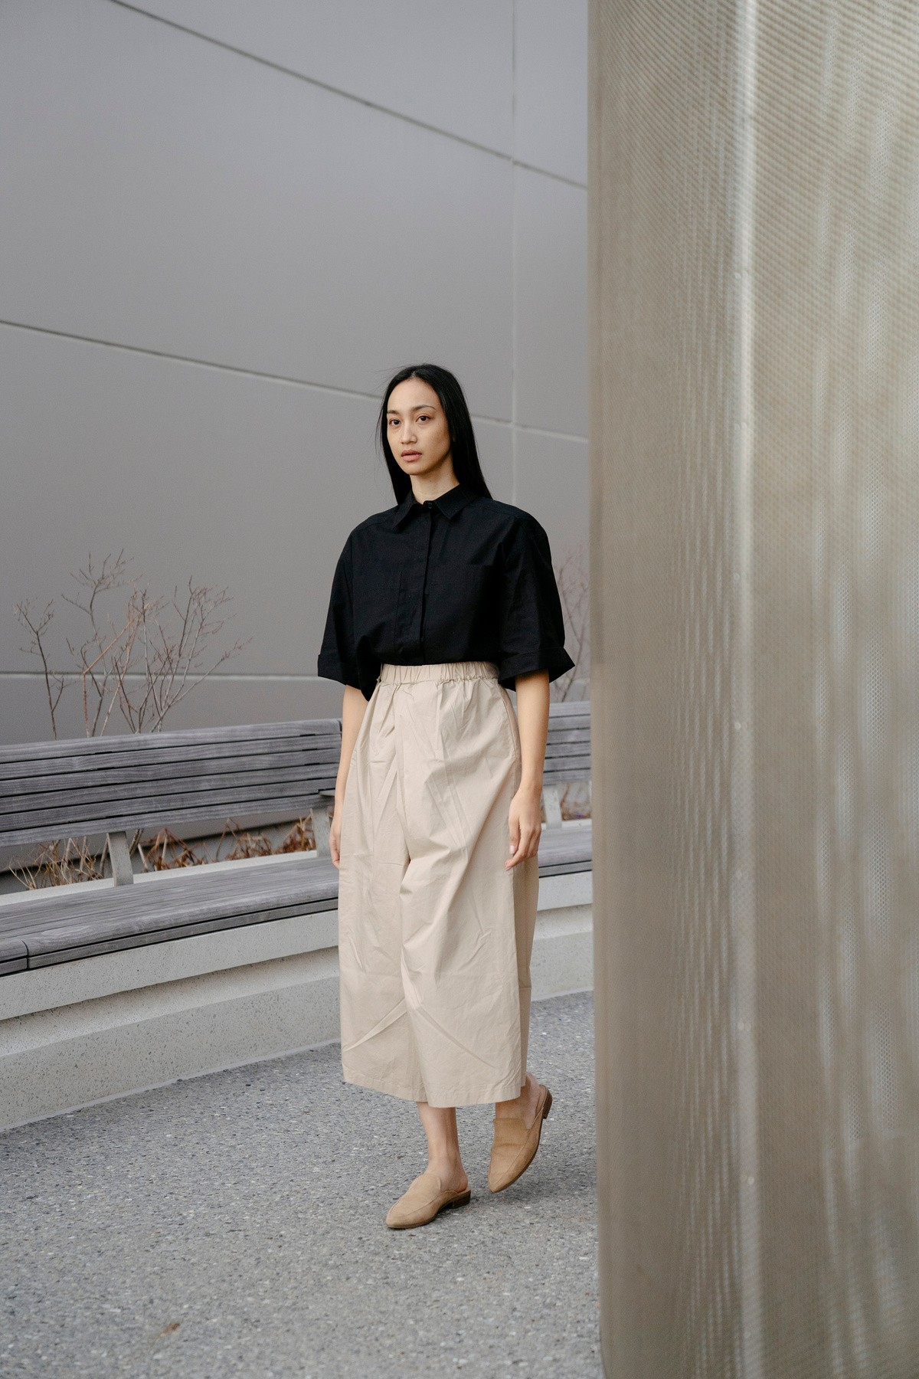
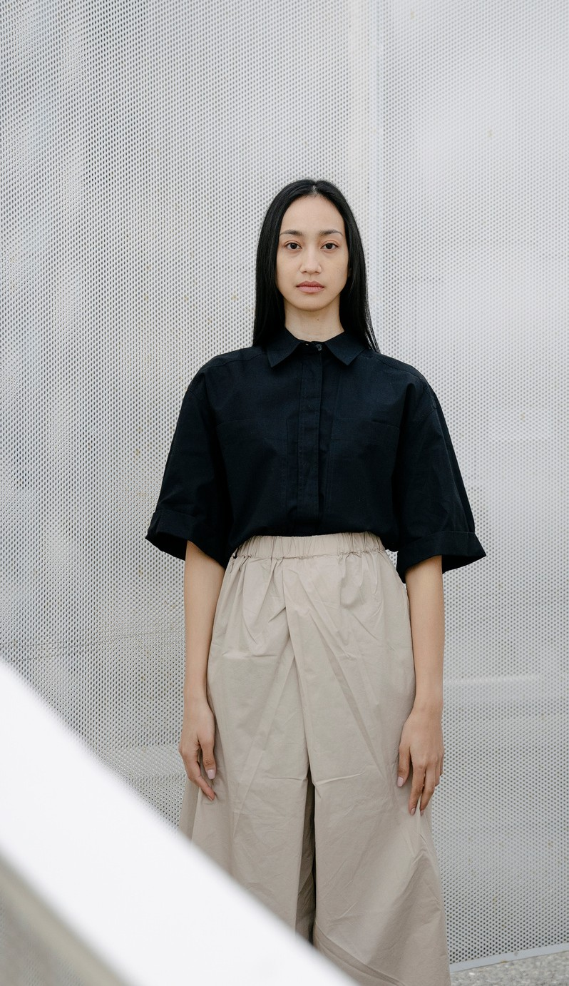
Casual look for spring. Made from organic cotton from Spain.
Ideal for a simple outing with friends or a casual date in the city

Slide 5
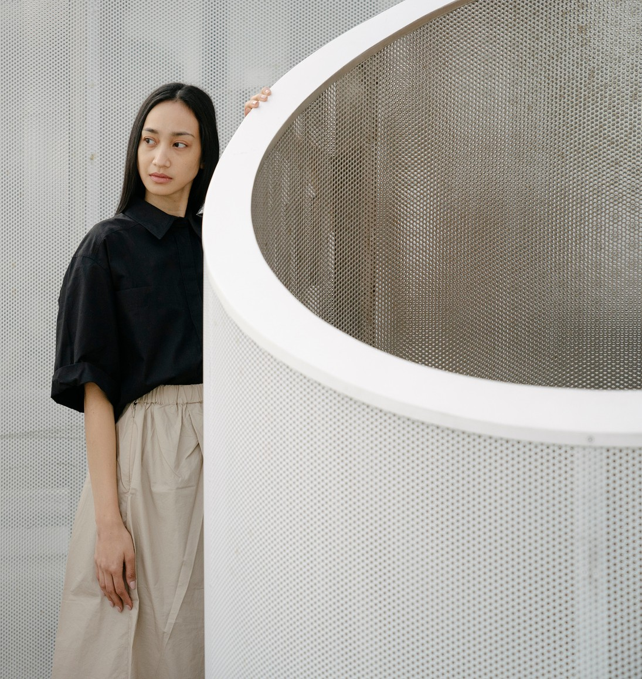
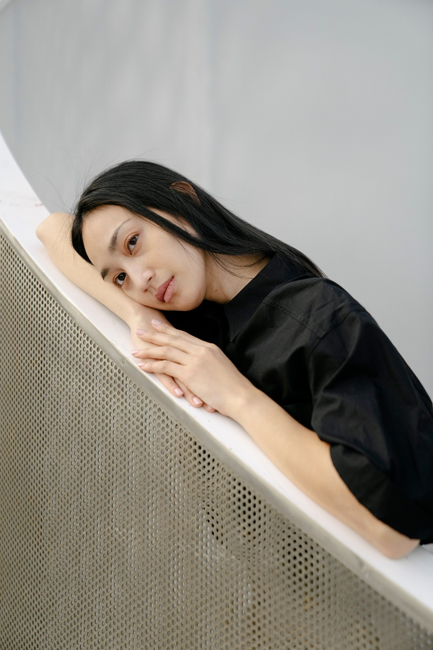

Slide 6
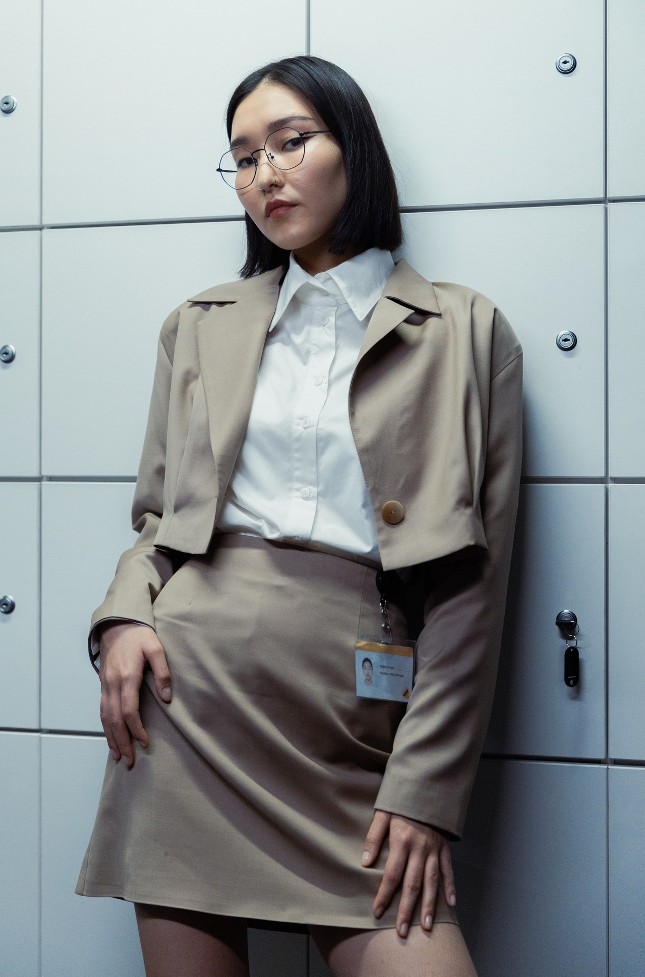
Business casual Ideal for a more relaxed
work day

Slide 7
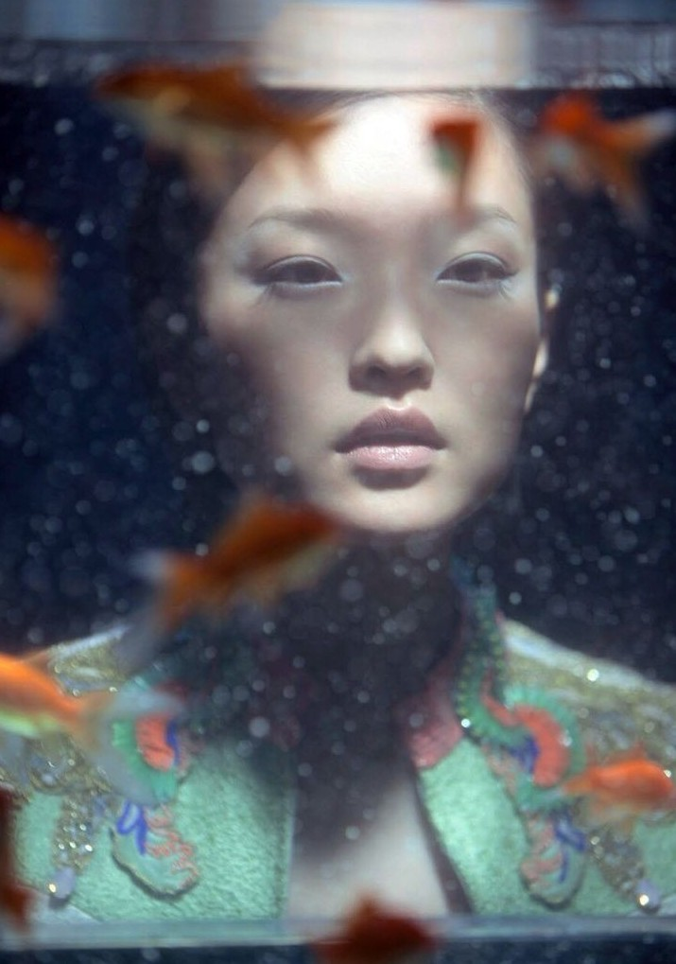

Slide 8
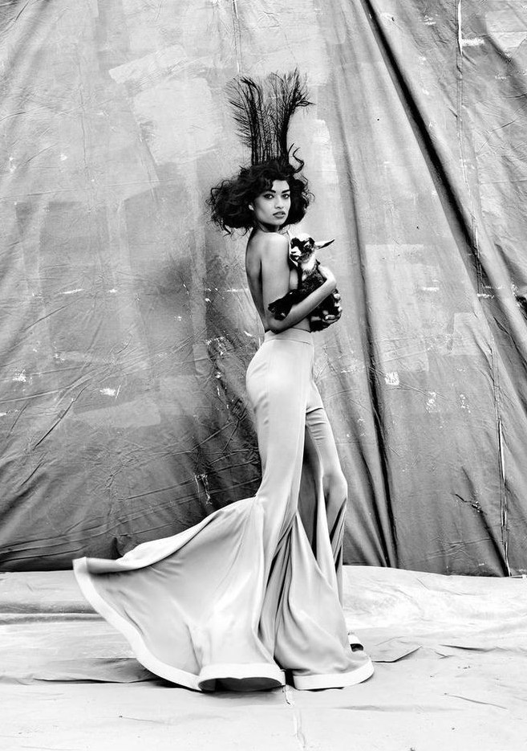

Slide 9
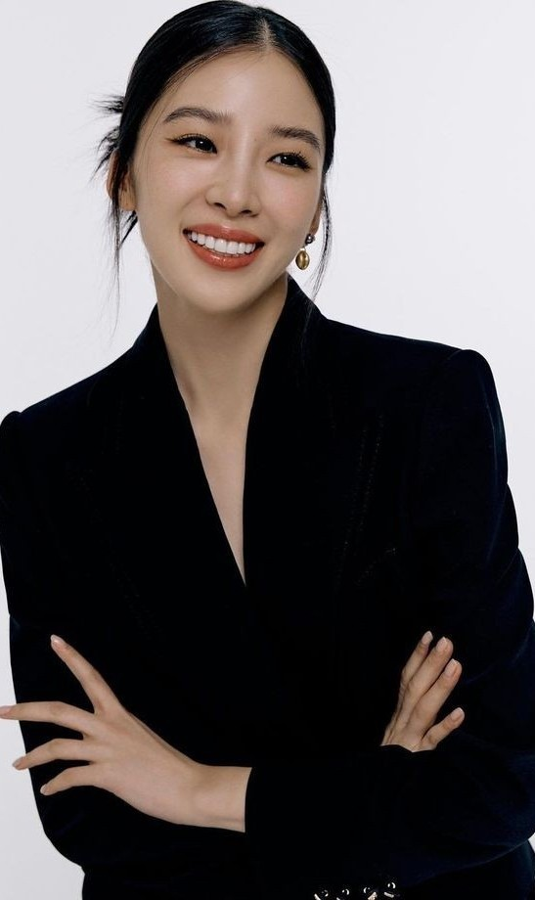
IRENE KIM
Digital superstar Irene Kim is rightfully the cover girl. Huge social following aside, her unabashed fearlessness to experiment in fashion and style is truly remarkable. She is constantly evolving and switching up her looks.

Slide 10
Du Juan, Chinese Spring

Slide 11
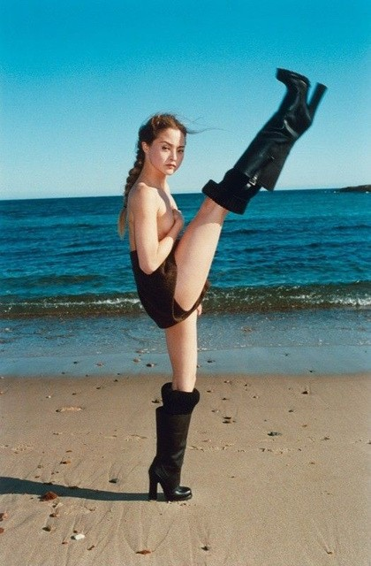
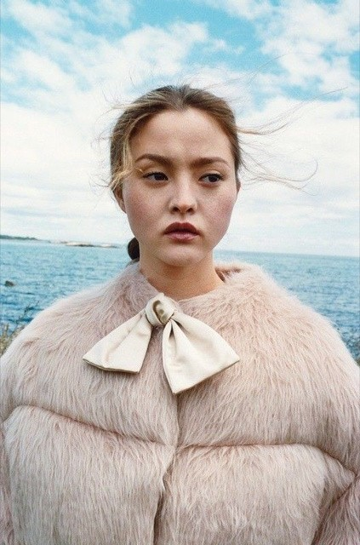
Devon Aoki
Daring sea

Slide 12
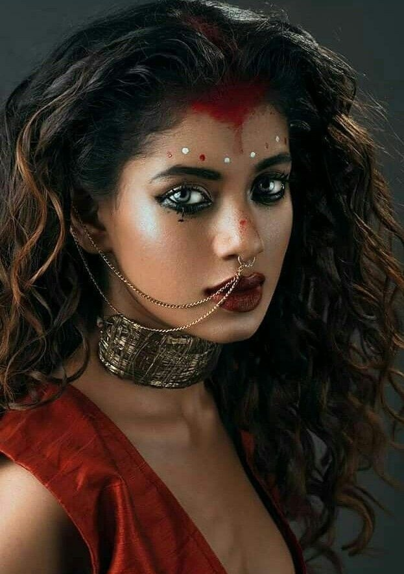

Slide 13
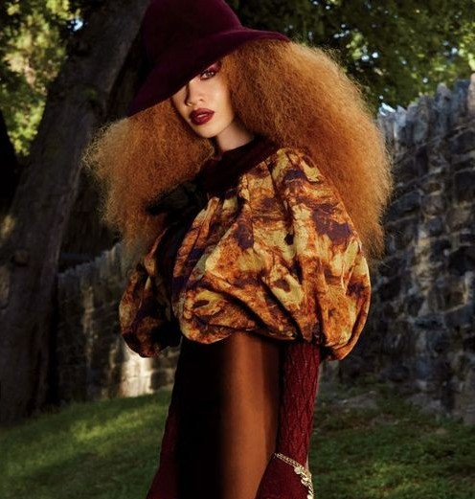
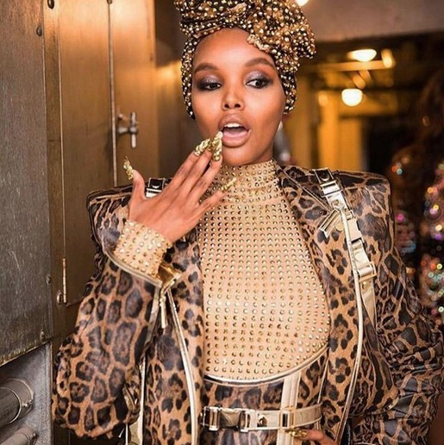
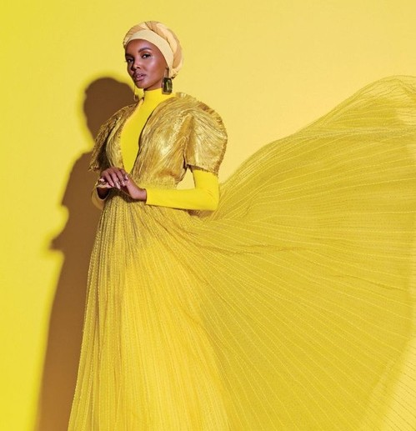
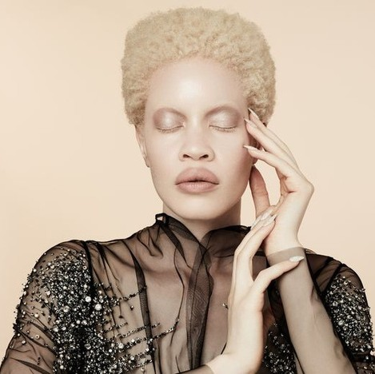

Slide 14
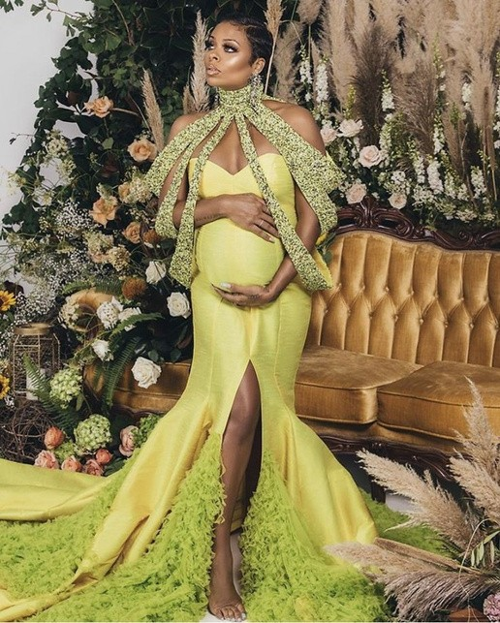
Eva Marcille

Slide 15
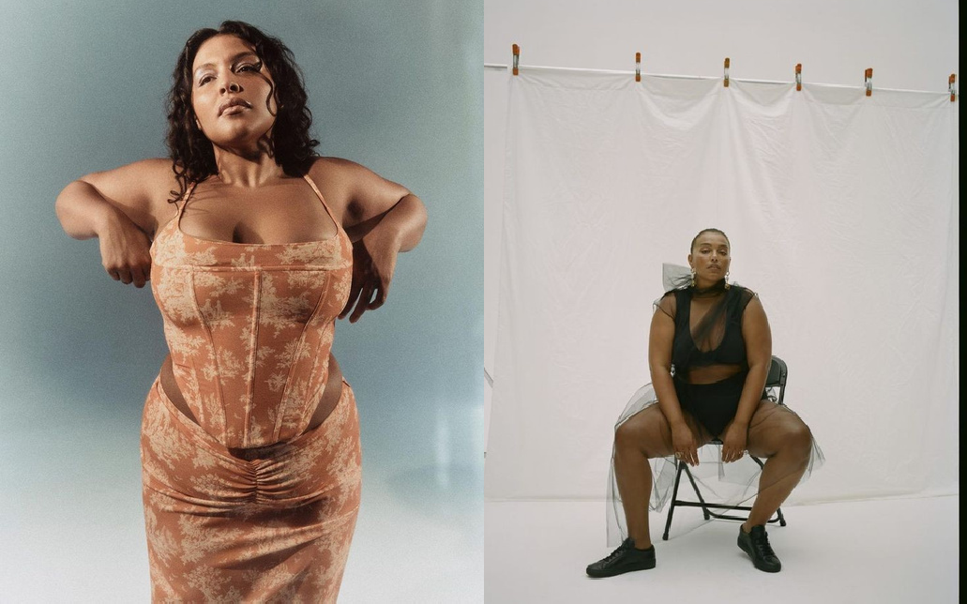
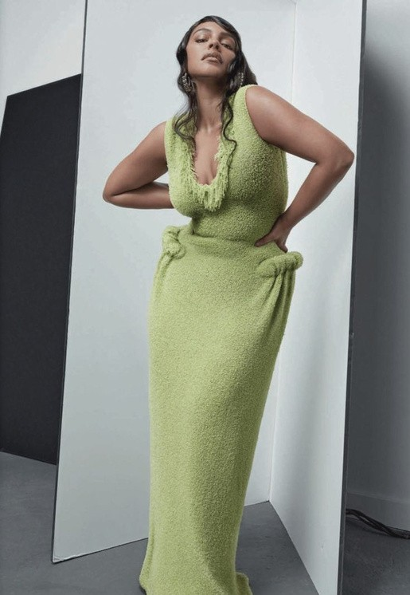

Slide 16
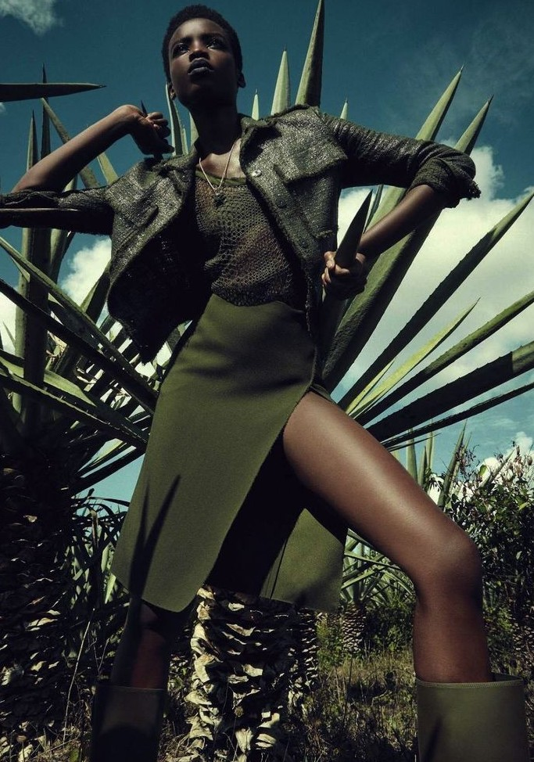

Slide 17
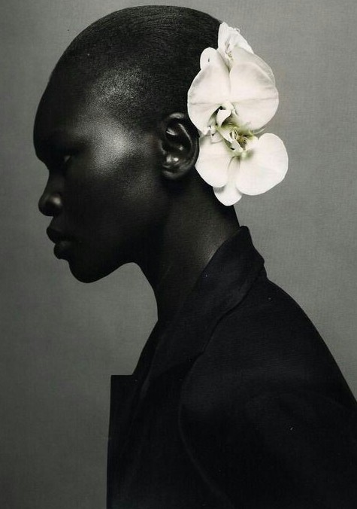

Slide 18
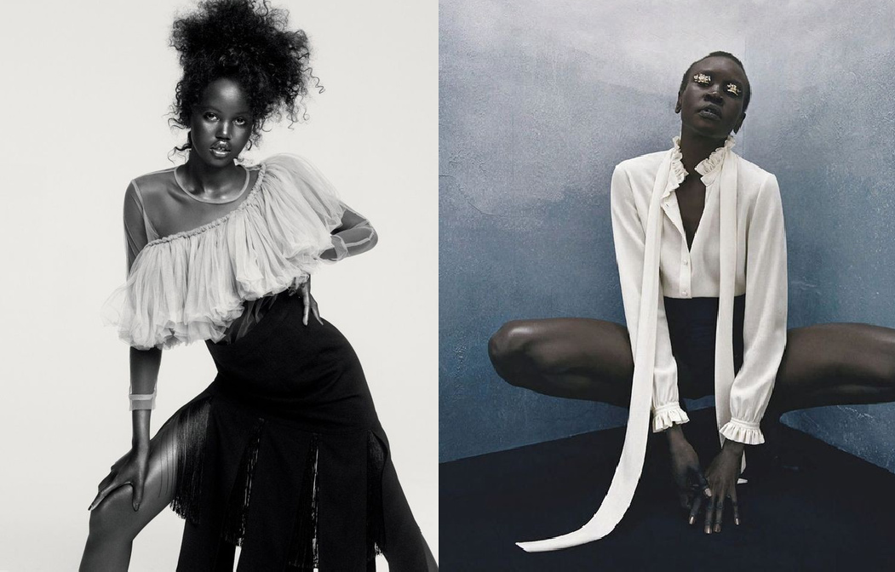

Slide 19
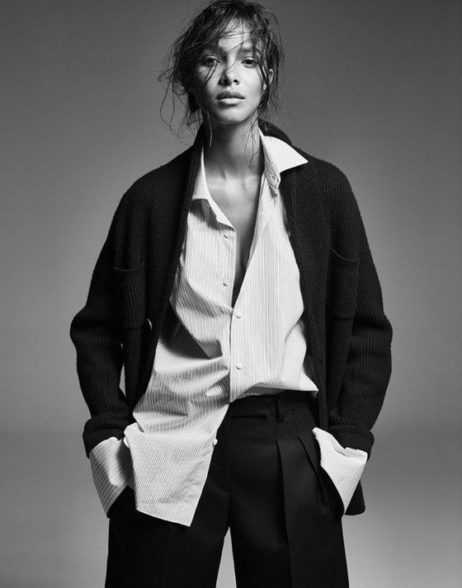

Slide 20
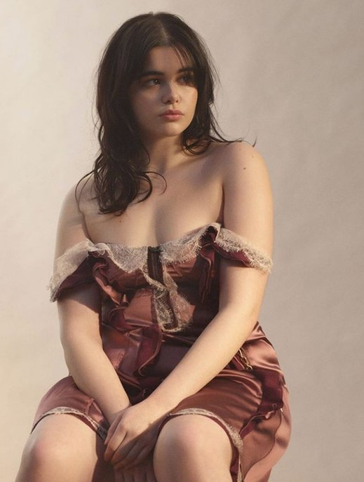
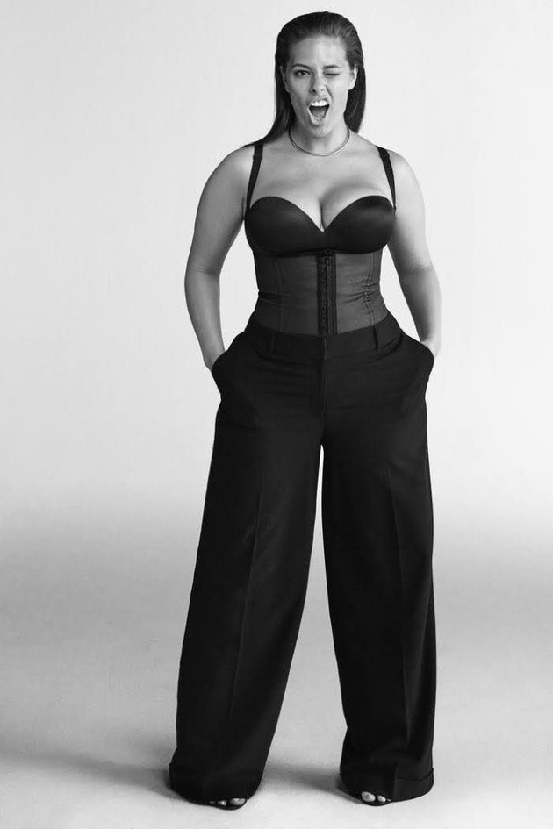
Corsets
Back in style
from casual to business

Slide 21
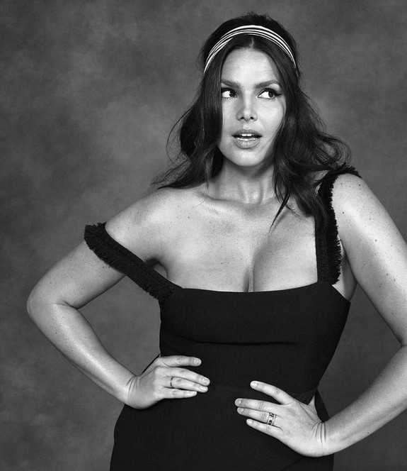
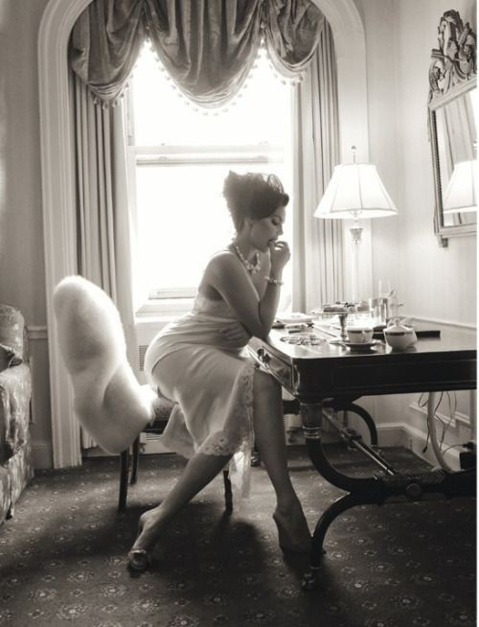

Slide 22
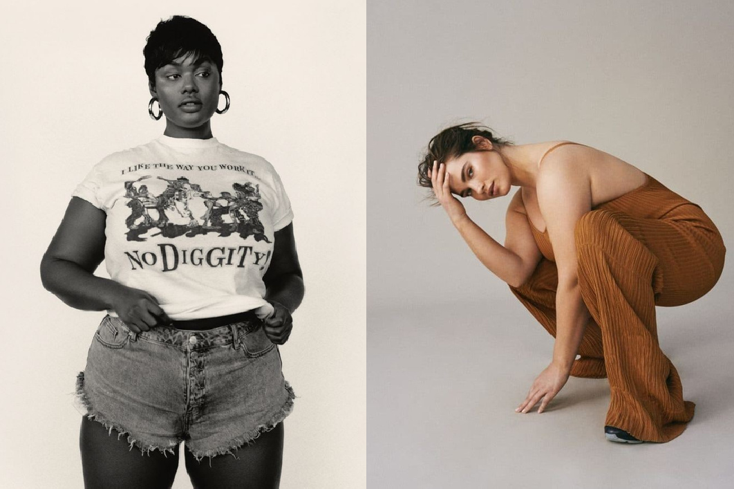
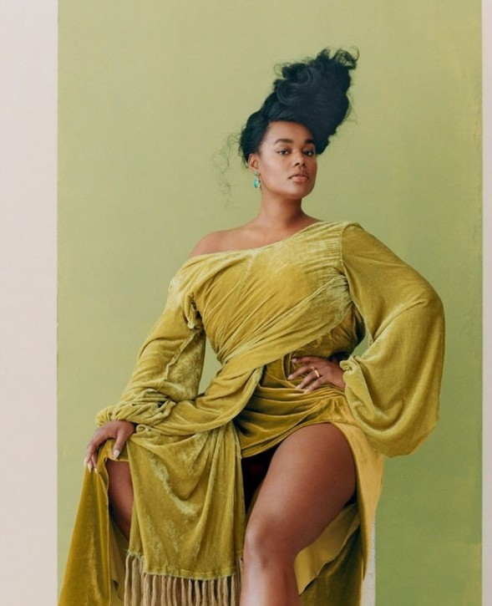

Slide 23
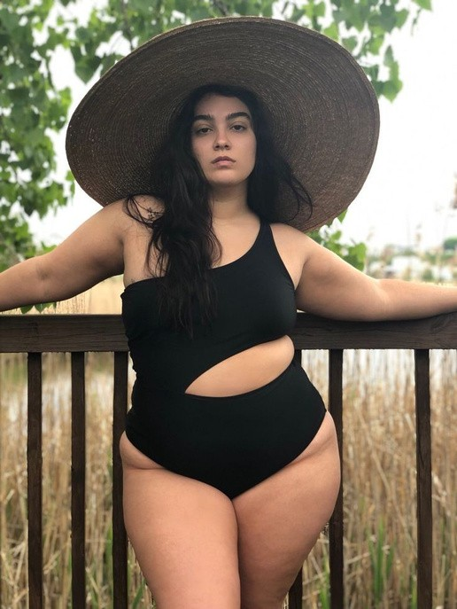
SUMMER
2023

Slide 24
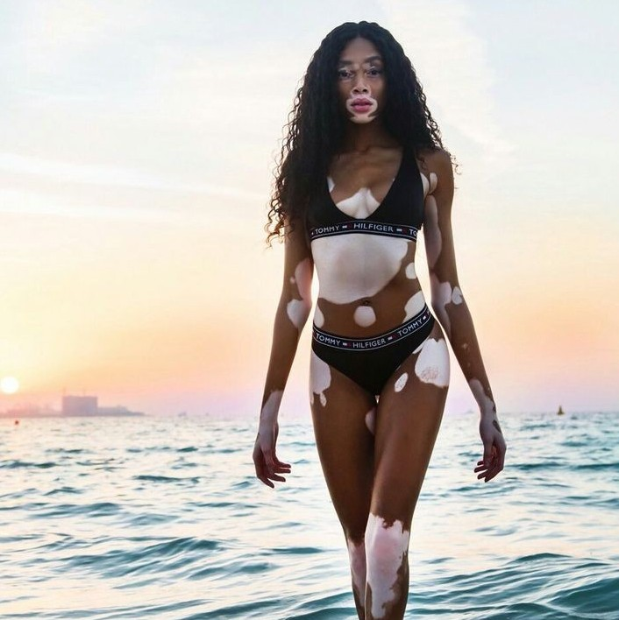
Winnie Harlow

Slide 25
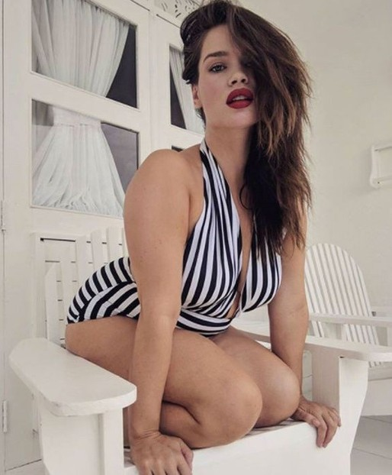
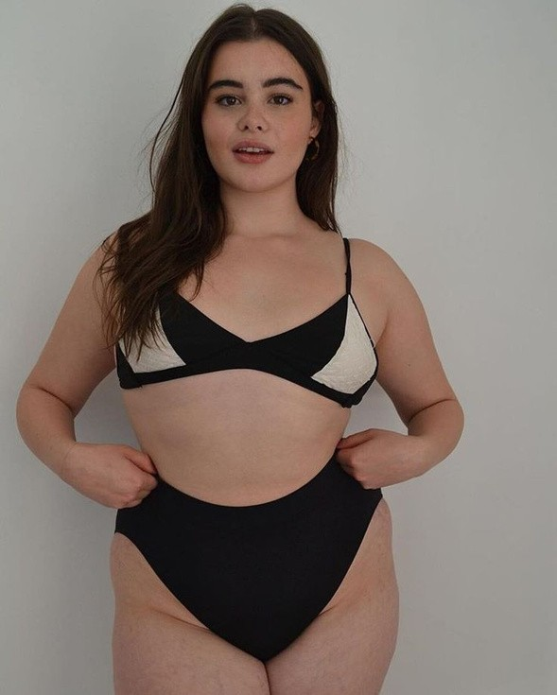
Back in style
Vintage style at the beach

Slide 26
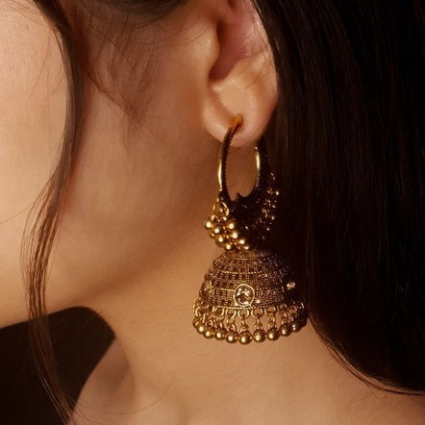
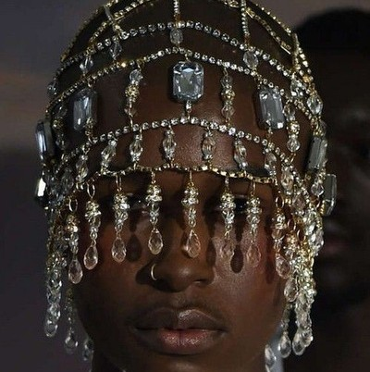
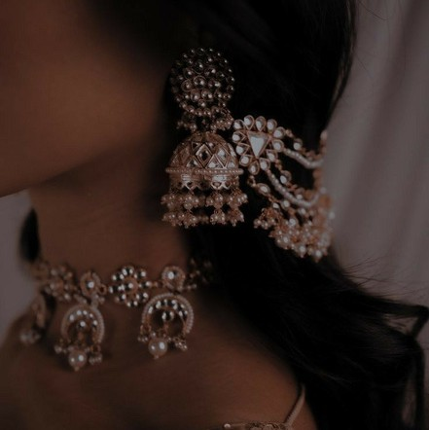
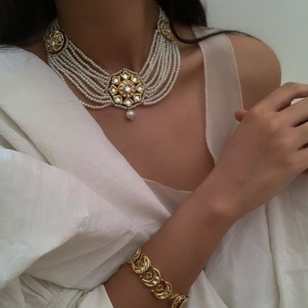
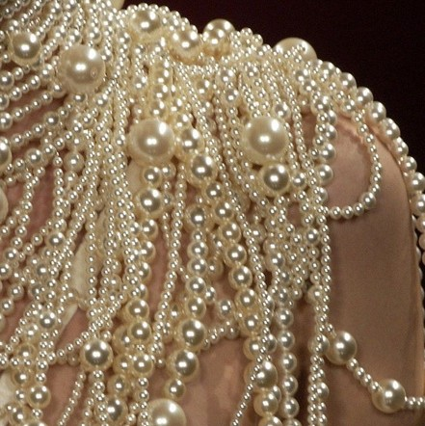
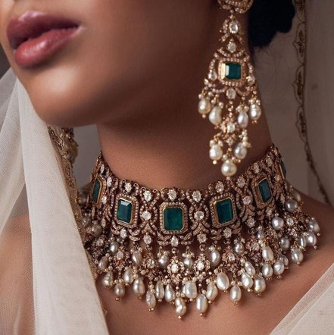

Slide 27
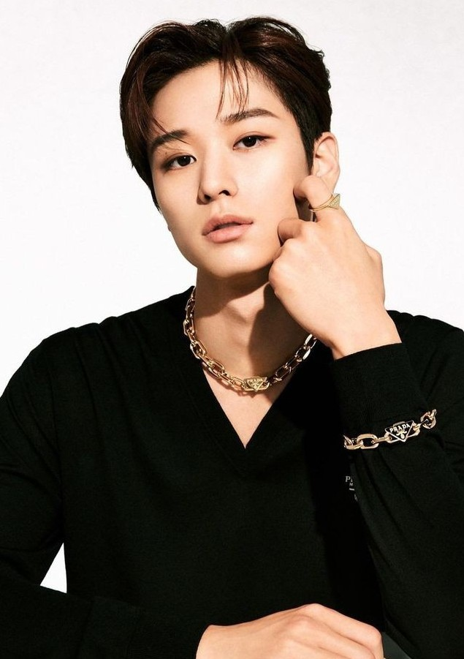

Slide 28
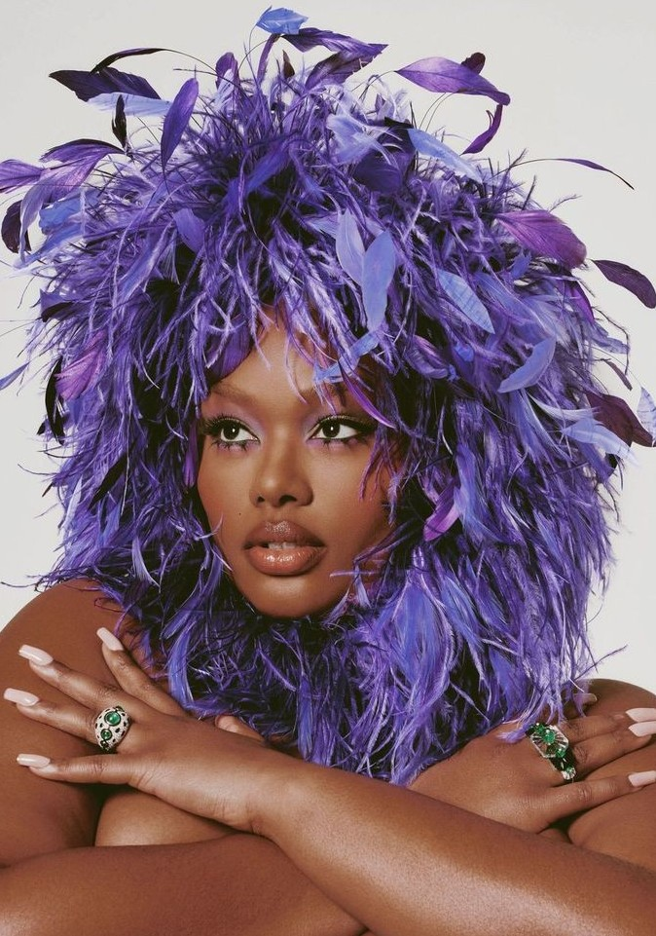

Slide 29
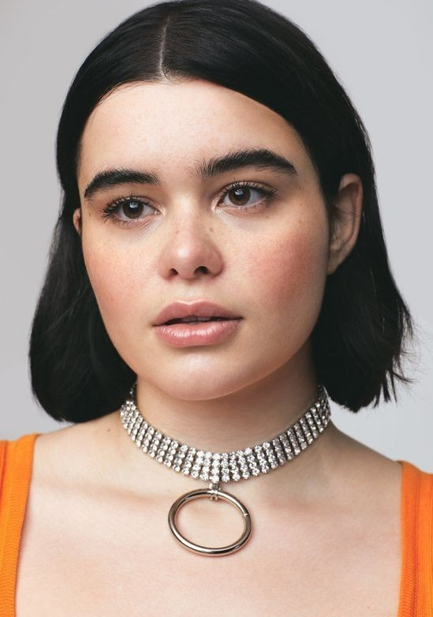

Slide 30
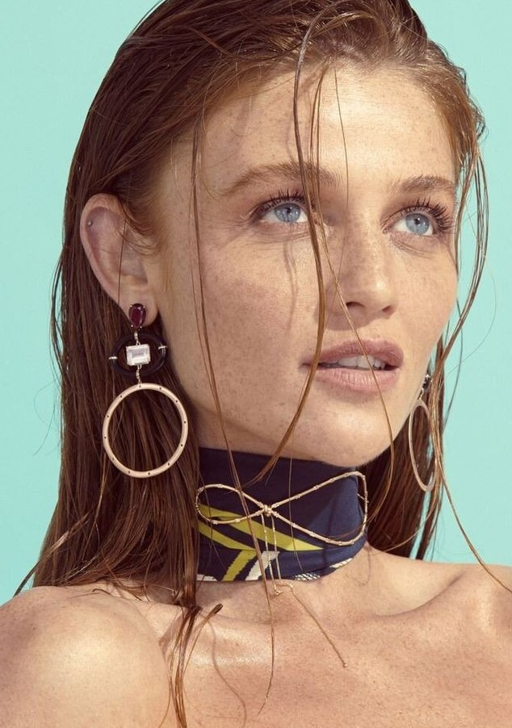

Slide 32
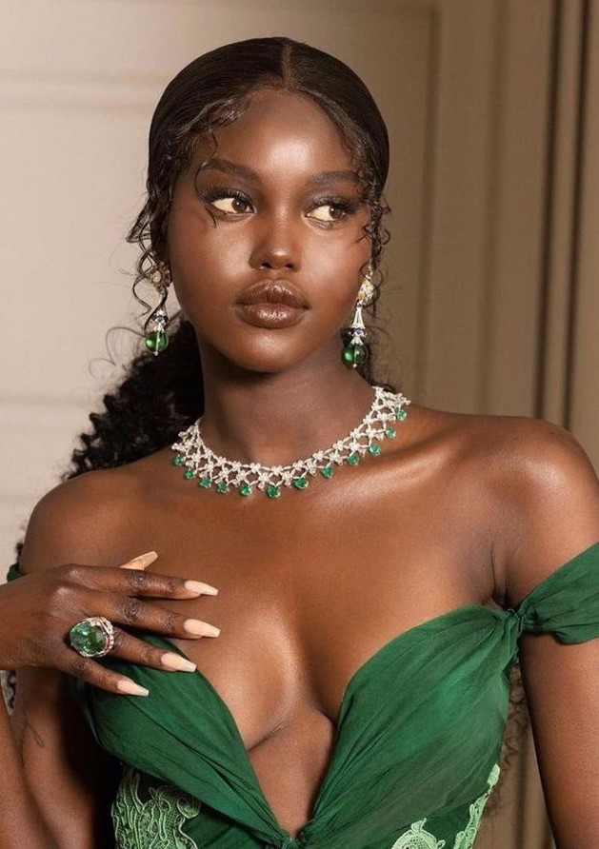

Slide 33
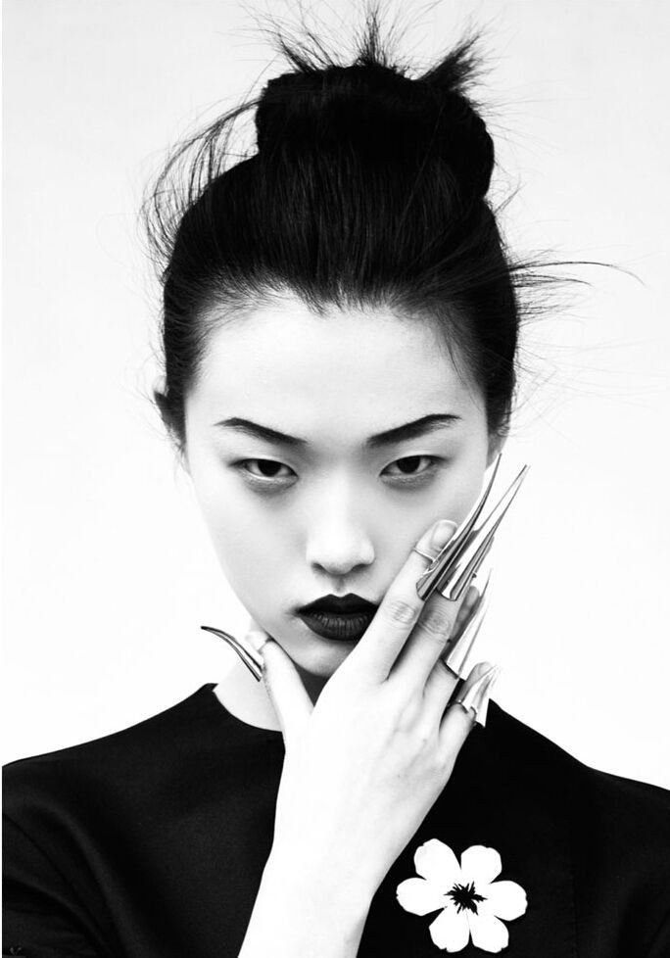

Slide 34
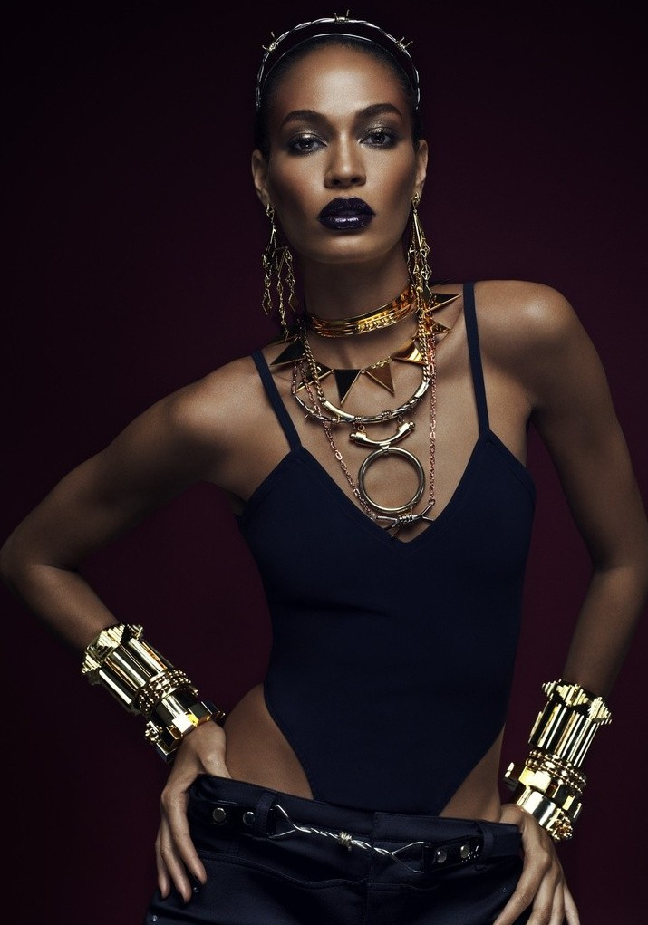

Slide 35
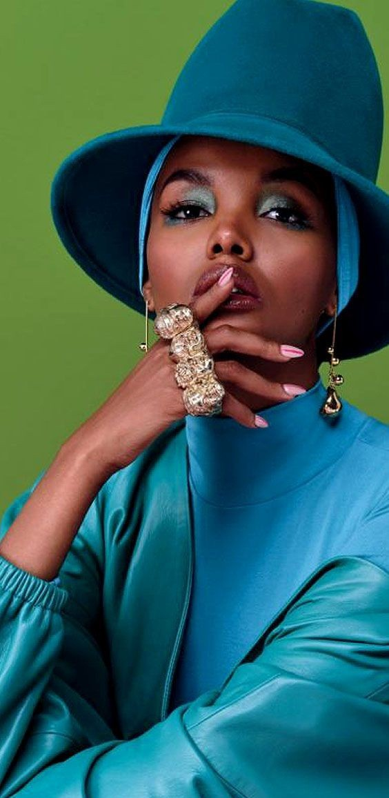

Slide 37
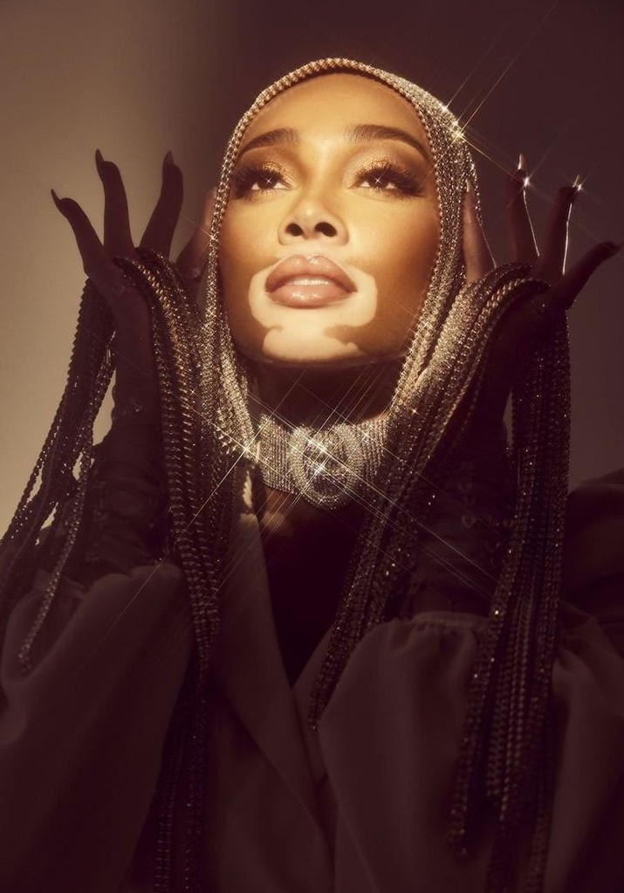

Slide 38
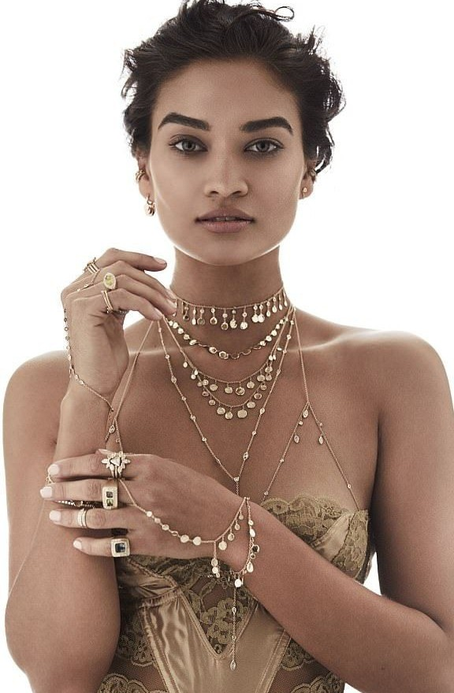

Slide 39
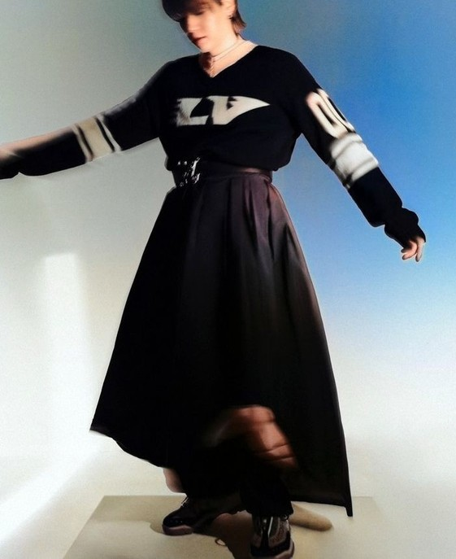
NEW
COLLLLECTIION

